Slide 1
ITC and Programming in C++
I/O Devices

Slide 2
Output Devices
An output device is an electromechanical device, which accepts data from computer and translate them into form, which is suitable for use by users.
Output devices can be categorized into
  Monitors
  Printers
  Plotters
  Screen image projectors
  Voice response systems

Slide 3
Monitors
The monitor is one of the most important output devices, it is used to display text and pictures.
Monitors are used today for producing soft-copy output
Monitor is a piece of electrical equipment which displays viewable images generated by a computer without producing a permanent record.
Monitor is of following types:
  Cathode ray tube (Normal Monitors)
  Flat panel (TFT LCD)

Slide 4
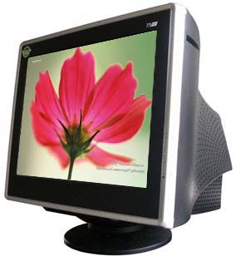
Cathode-ray-Tube (CRT)

Slide 5
Cathode-Ray-Tube (CRT)
The CRT or cathode ray tube, is the picture tube of a monitor. The back of the tube has a negatively charged cathode. The electron gun shoots electrons down the tube and onto a charged screen. The screen is coated with a pattern of dots that glow when struck by the electron stream. Each cluster of three dots, one of each color, is one pixel.

Slide 6
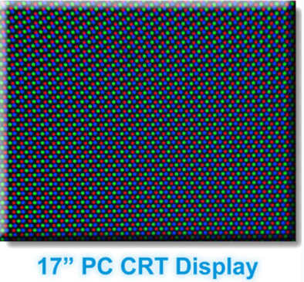
Cathode-Ray-Tube

Slide 7
Cathode-Ray-Tube
The image on the monitor screen is usually made up from at least tens of thousands of such tiny dots glowing on command from the computer. The closer together the pixels are, the sharper the image on screen. The distance between pixels on a computer monitor screen is called its dot pitch and is measured in millimeters. Most monitors have a dot pitch of 0.28 mm or less.

Slide 8
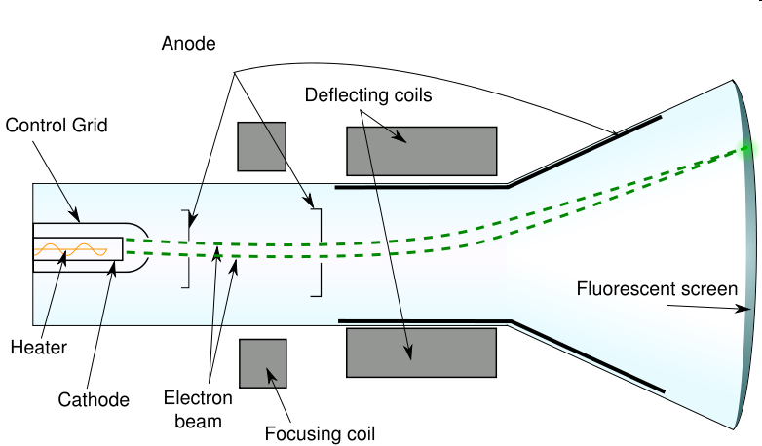
Cathode-Ray-Tube
There are two electromagnets around the collar of the tube which deflect the electron beam. The beam scans across the top of the monitor from left to right, is then blanked and moved back to the left-hand side slightly below the previous trace (on the next scan line), scans across the second line and so on until the bottom right of the screen is reached. The beam is again blanked, and moved back to the top left to start again. This process draws a complete picture, typically 50 to 100 times a second.

Slide 9
Cathode-Ray-Tube
The number of times in one second that the electron gun redraws the entire image is called the refresh rate and is measured in hertz (cycles per second).
If your CRT monitor has a refresh rate of 72 Hertz (Hz), then it cycles through all the pixels from top to bottom 72 times a second. Refresh rates are very important because they control flicker, and you want the refresh rate as high as possible. Too few cycles per second and you will notice a flickering, which can lead to headaches and eye strain.

Slide 10
LCD(Basics)
A liquid crystal display (commonly abbreviated LCD) is a thin, flat display device made up of any number of color or monochrome pixels arrayed in front of a light source or reflector. It uses very small amounts of electric power, and is therefore suitable for use in battery-powered electronic devices.

Slide 11
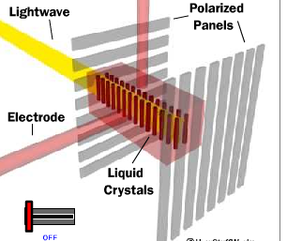
LCD(Working)
Specifically, an LCD is made of two pieces of polarized glass (also called substrate) that contain a liquid crystal material between them. A backlight creates light that passes through the first substrate. At the same time, electrical currents cause the liquid crystal molecules to align to allow varying levels of light to pass through to the second substrate and create the colors and images that you see.

Slide 12
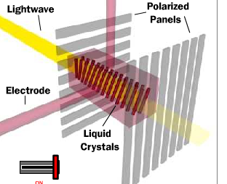
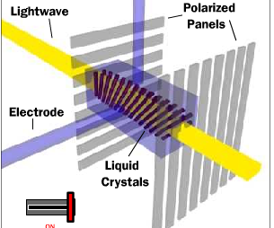
LCD(Working)

Slide 13
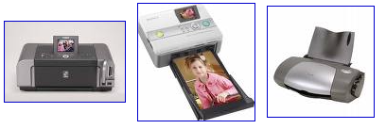
Printers
A computer printer, or more commonly a printer, produces a hard copy (permanent human-readable text and/or graphics) of documents stored in electronic form, usually on physical print media such as paper transparencies.

Slide 14
Impact vs. Non-impact
Impact- These printers have a mechanism that touches the paper in order to create an image. There are two main impact technologies:
    Dot matrix printers use a series of small pins to strike a ribbon coated with ink, causing the ink to transfer to the paper at the point of impact.
    Character printers are basically computerized typewriters. They have a ball or series of bars with actual characters (letters and numbers) embossed on the surface. The appropriate character is struck against the ink ribbon, transferring the character's image to the paper. Character printers are fast and sharp for basic text, but very limited for other use.
Non-impact - These printers do not touch the paper when creating an image.
    Inkjet printers use a series of nozzles to spray drops of ink directly on the paper.
    Laser printers use dry ink (toner), static electricity, and heat to place and bond the ink onto the paper.

Slide 15
Printers – Dot Matrix
A dot matrix printer or impact matrix printer refers to a type of computer printer with a print head that runs back and forth on the page and prints by impact, striking an ink-soaked cloth ribbon against the paper, much like a typewriter. Unlike a typewriter or daisy wheel printer, letters are drawn out of a dot matrix, and thus, varied fonts and arbitrary graphics can be produced.
Dot-Matrix printers are normally slow with speeds usually ranging between 30 to 600 character per second.

Slide 16
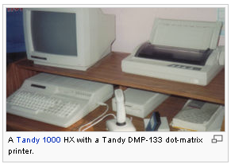
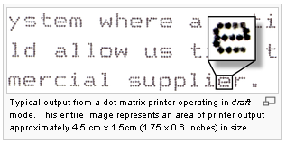
Dot Matrix

Slide 17
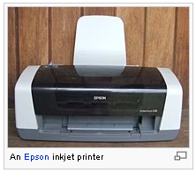
Printers – Ink Jet
Inkjet printers are a type of computer printer that operates by spraying tiny droplets of liquid ink onto paper. The print head of an inkjet printer contains up to 64 tiny nozzles, which can be selectively heated up in a few seconds by integrated circuit register. When the register heats up, the ink near it vaporizes, and is ejected through the nozzle, and makes a dot on the paper placed in front of the print head. They are the most common type of computer printer for the general consumer due to their low cost, high quality of output, capability of printing in vivid color, and ease of use.

Slide 18
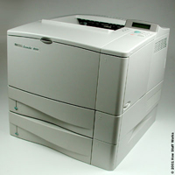
Printers – Laser Printer
Laser Printers are page printers, which print one page at a time.
A laser printer is a common type of computer printer that rapidly produces high quality text and graphics on plain paper..

Slide 19
Laser Printers (working)
The main components of laser printer are
  Laser beam source
  Multi-sided mirror
  Drum
  Toner
To print a page, the laser beam is focused on the electro static charged drum by spinning multi sided mirror. The mirror focuses the laser beam on the surface of the drum in a manner to create the pattern of character/images to be printed on the page. The toner sticks to the drum in the places, where the laser beam has charged the drum’s surface. The toner is then permanently fused on the paper with heat and pressure to generate the printed output. The drum is than rotated and than cleaned with the rubber blade to remove the toner sticking to its surface to prepare the drum form the next page printing.

Slide 20
Laser Printer
Laser printers have many significant advantages over other types of printers. Unlike impact printers, laser printer speed can vary widely, and depends on many factors, including the graphic intensity of the job being processed. The fastest models can print over 200 monochrome pages per minute (12,000 pages per hour). The fastest color laser printers can print over 100 pages per minute (6000 pages per hour). Very high-speed laser printers are used for mass mailings of personalized documents, such as credit card or utility bills

Slide 21

Plotters
A plotter produces its output using special pens across the paper to create a drawing. Engineers, architects and designers use plotters to produce their drawings or designs.

Slide 22
Plotters
Two common types of plotters
Drum Plotters
  In the drum plotter the paper is placed on the drum, which can rotate in both clockwise and anti-clockwise direction to produce vertical motion. The pens are mounted perpendicular to the drum’s surface and can move left to right and right to left to produce horizontal motion.
Flatbed Plotters
  A flatbed plotters plots a design on a sheet of paper which is fixed over a rectangular flatbed table. In this type of plotter, the paper does not move, and the pen holding mechanism is designed to provide all types of motions necessary to draw complex design and graphs.

Slide 23
Screen Image Projector
Screen image projector is an output device, which is used to project information from a computer on to a large screen, so that it can be viewed by a large group of people.
This output device is very useful for making presentations to a group of people with a direct use of a computer.
Before this device, overhead projector were used for presentation using transparency sheets.

Slide 24
Voice Response Systems
Just as a voice recognition system allows a user to talk to a computer, similarly, a voice response system enables a computer to talk to a user.
A voice response system has an audio-response device, which produces audio output.
A voice response system produces audio output by selecting an appropriate audio output from a set of pre-recorded audio responses.

